Slide 1
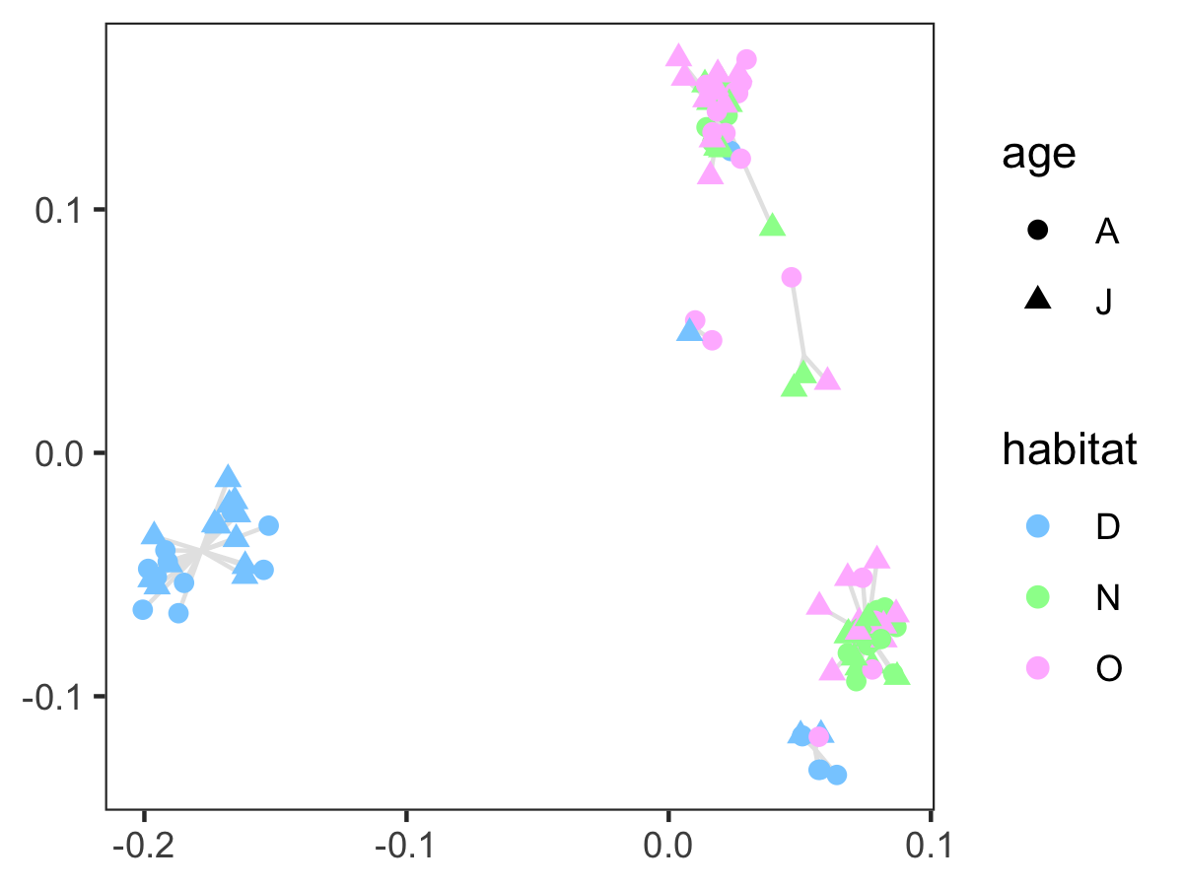
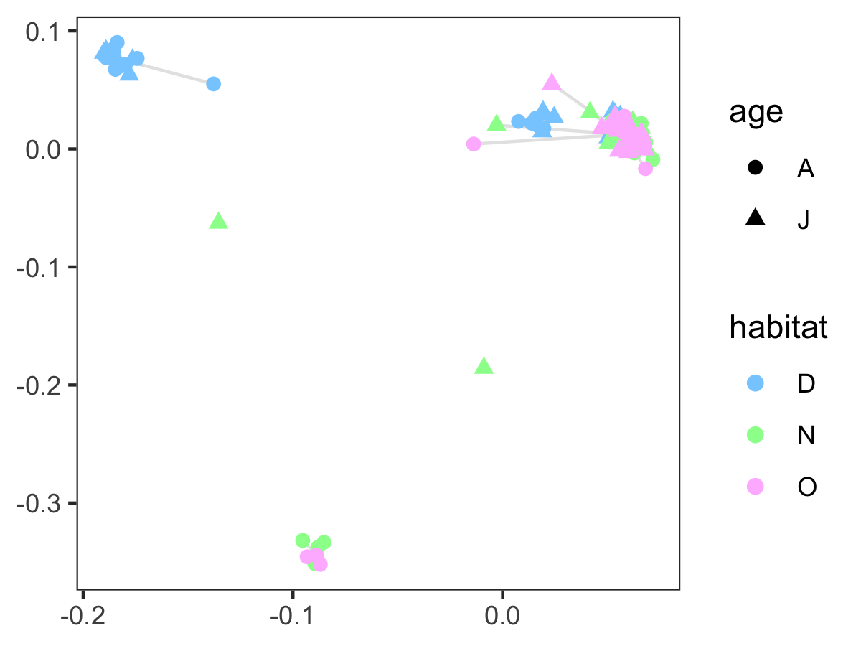
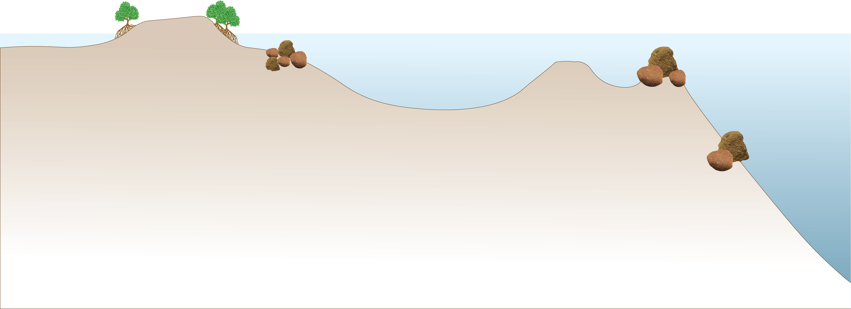
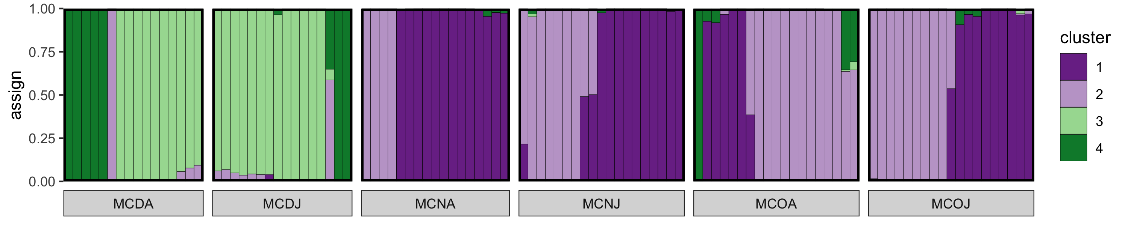
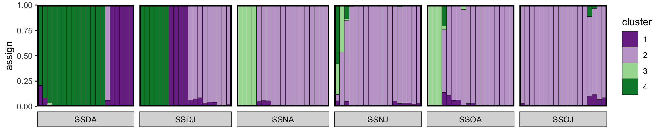
Montastraea cavernosa
Siderastrea siderea
NEARSHORE
OFFSHORE
DEEP
Montastraea cavernosa
Siderastrea siderea
A
J
A
J
A
J

Slide 2
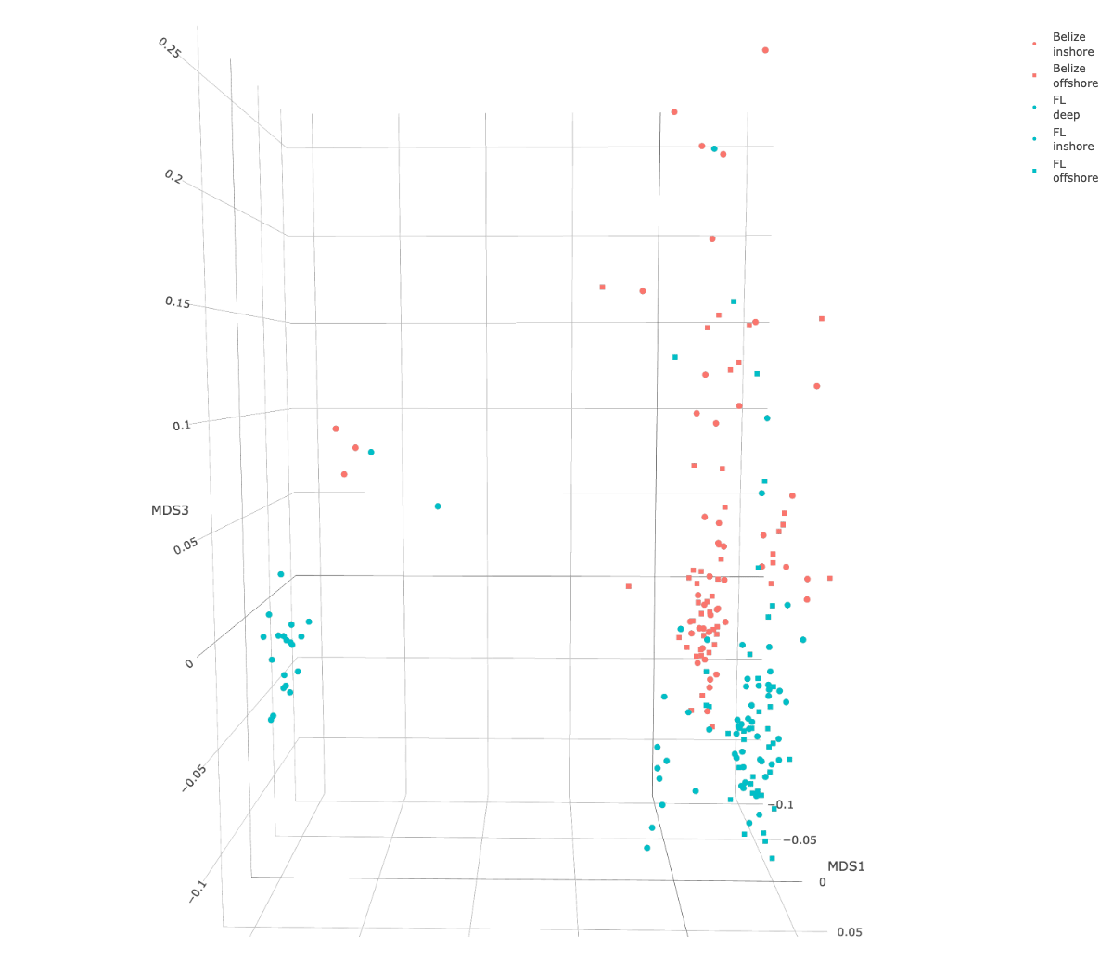
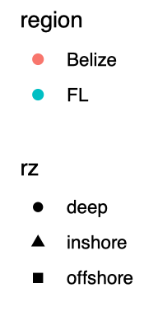

Slide 3
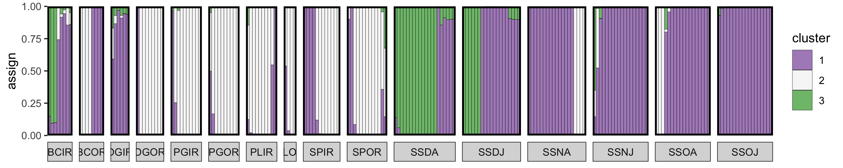
Belize
FL Keys

Slide 4
Belize
FL Keys

Slide 5
Belize
FL Keys

Slide 6
Belize
FL Keys

Slide 7
Belize
FL Keys

Slide 8
Turbidity:

